Slide 1
Light scattering enhancement factor: Discrepancies between model and Observations
Dominic Heslin-Rees

Slide 2
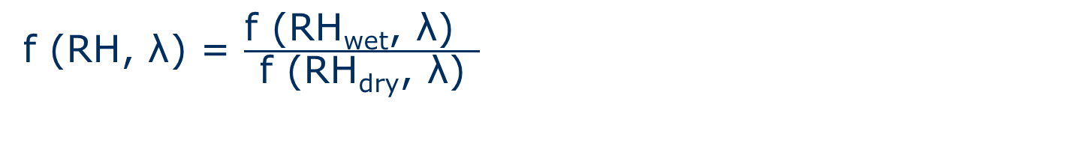
Introduction
The scattering enhancement factor f (RH, λ) describes the effect of water uptake on the particle light scattering.
f (RH, λ) = $\frac{\text{f}\text{ (}\text{R}\text{H}\text{wet}\text{, }\text{λ}\text{) }}{\text{f}\text{ (}\text{RH}\text{dry}\text{, }\text{λ}\text{)}}$
Depends on size and chemical composition
~ 1.28 for mineral dust
Up to 3.41 for Arctic aerosol

Slide 3
Motivation
How well do models represent aerosol hygroscopic growth
Compare with insitu observations for f(RH) at Barrow, Alaska
Assess the influence of the different definitions of dry conditions (RH=0,40 %)

Slide 4
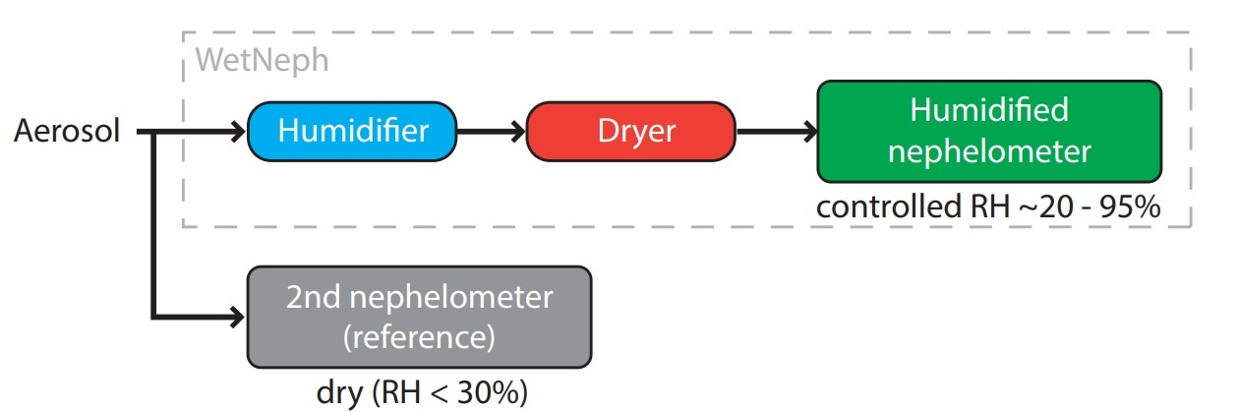
Method
Model: Atras, CAM, Chem, Oslo & Globase (year = 2010, frequ = daily and hourly)
Insitu measurements: Barrow (year = 2010, freq = 6 hours)
Temporally collocated

Slide 5
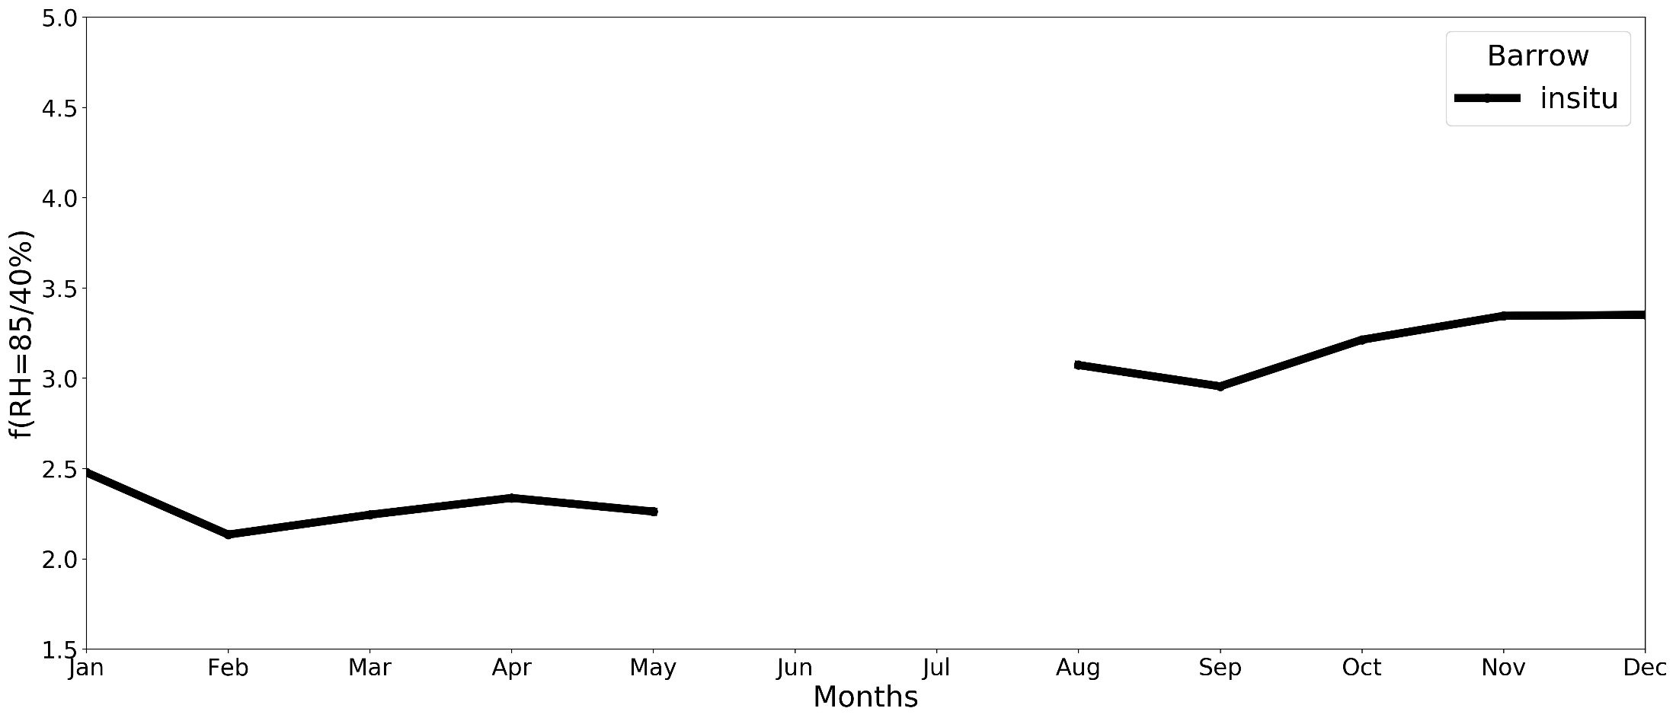
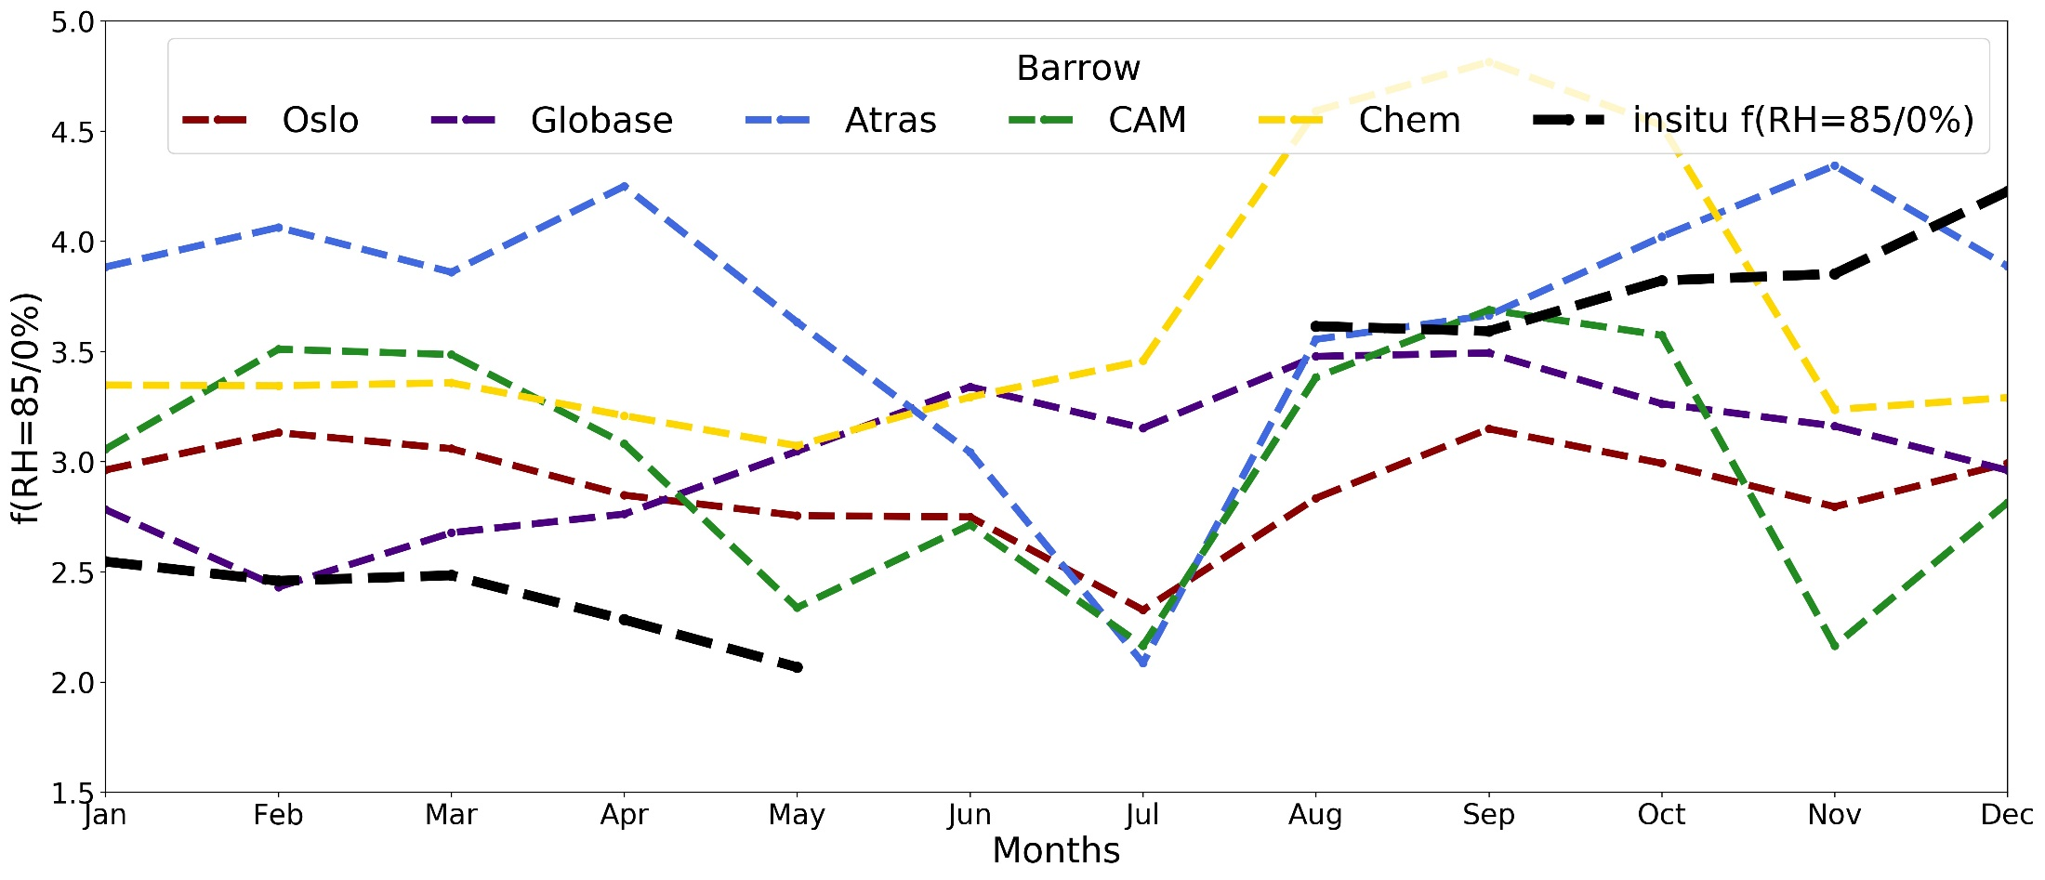
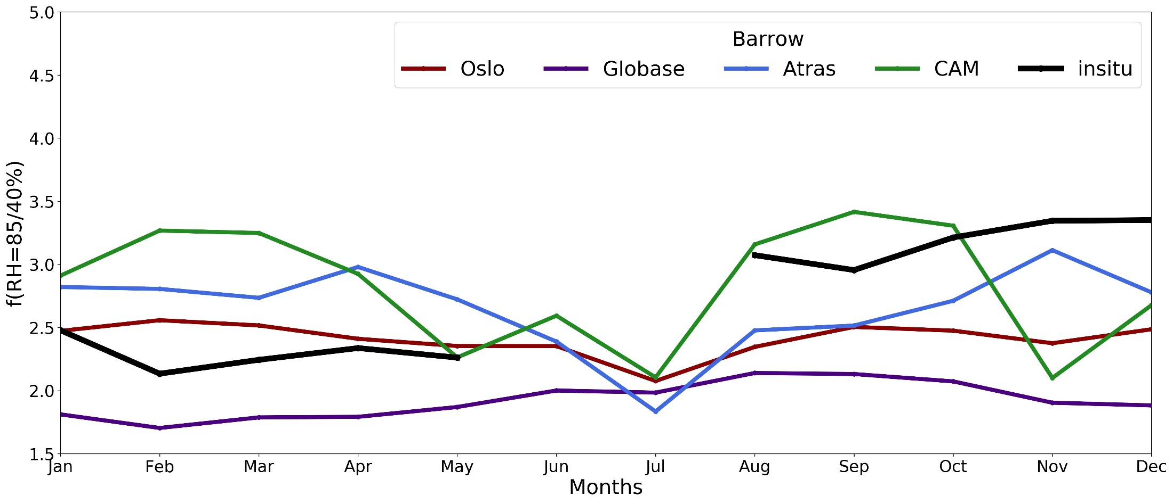
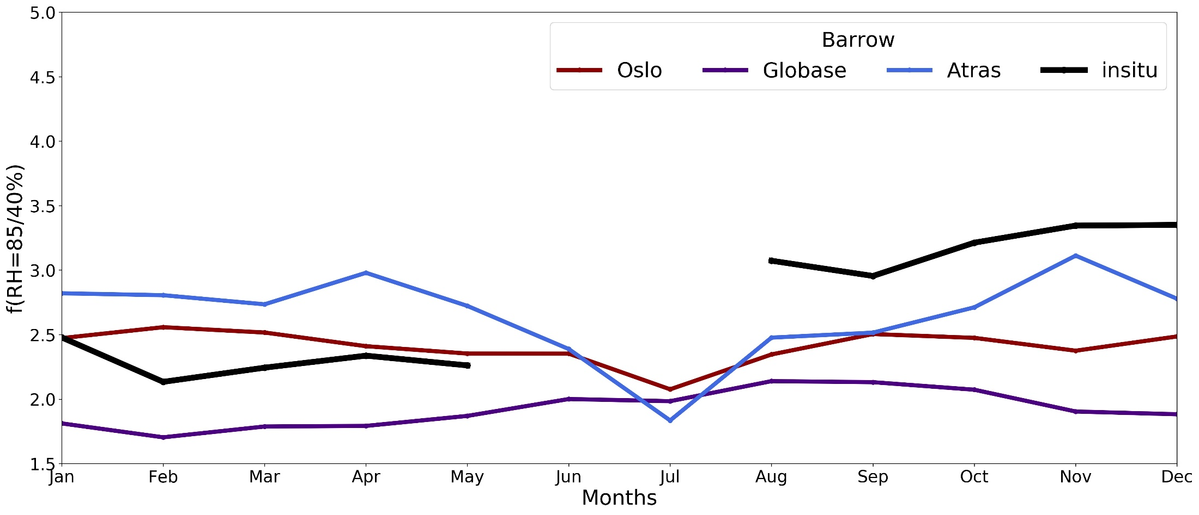
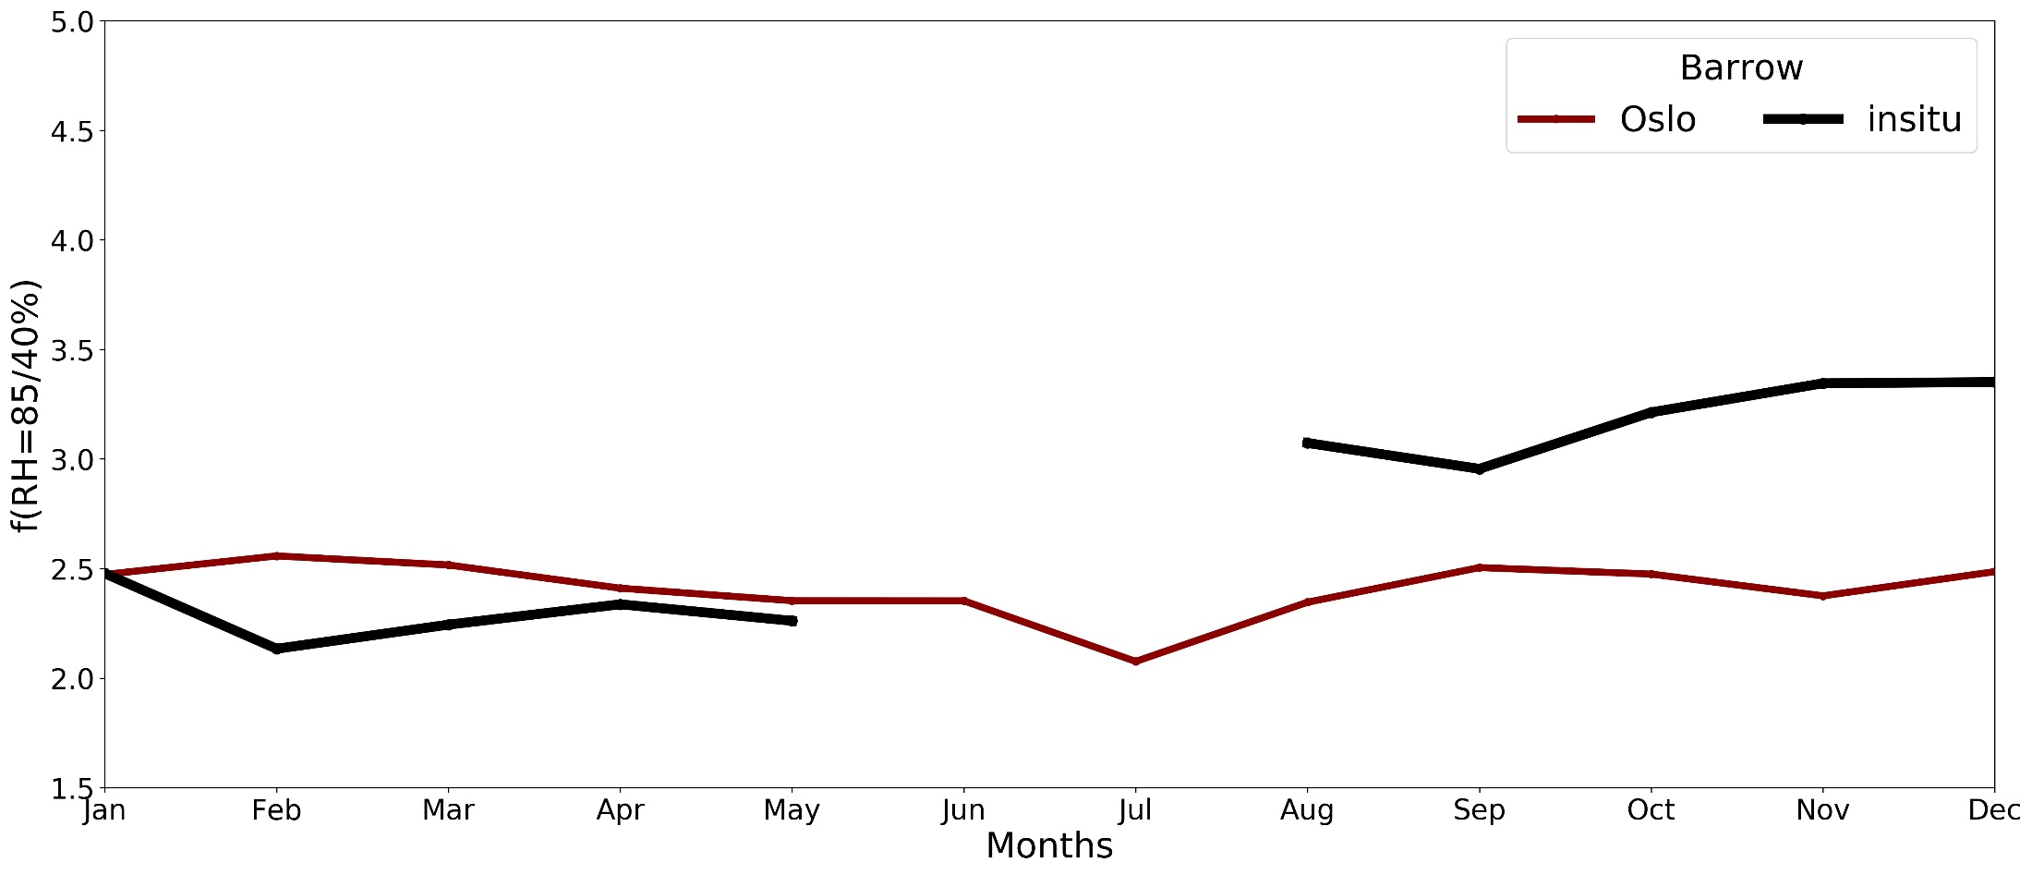
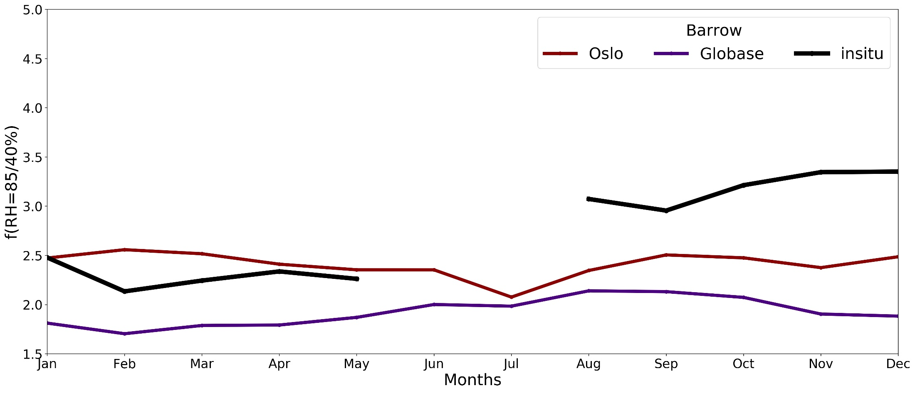
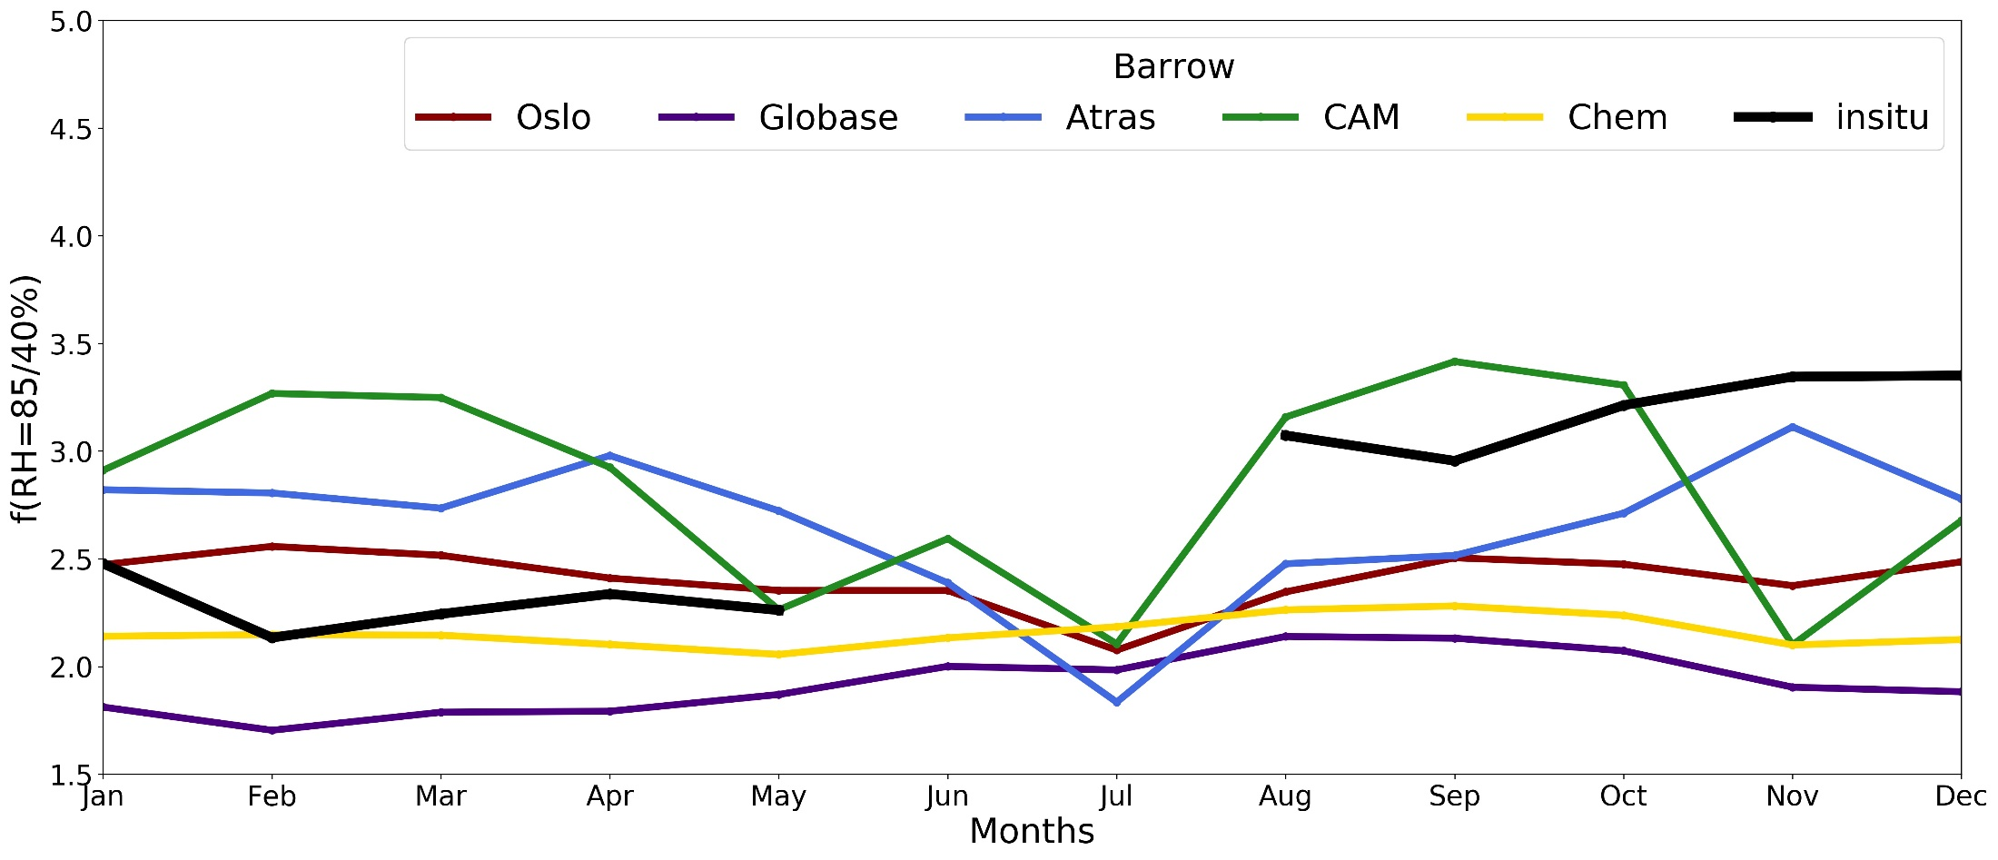
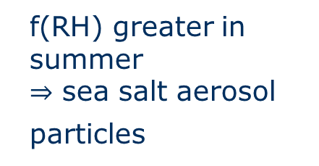
f(RH) greater in summer
sea salt aerosol particles

Slide 6
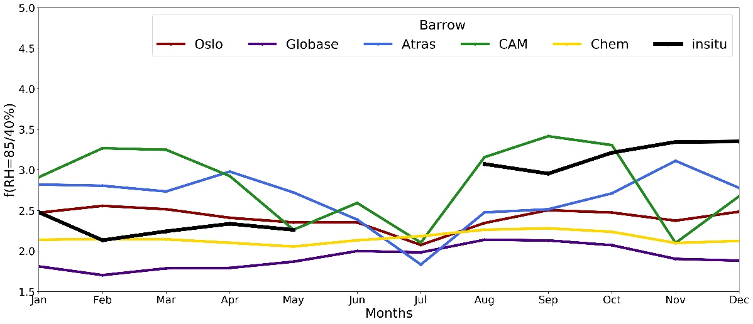
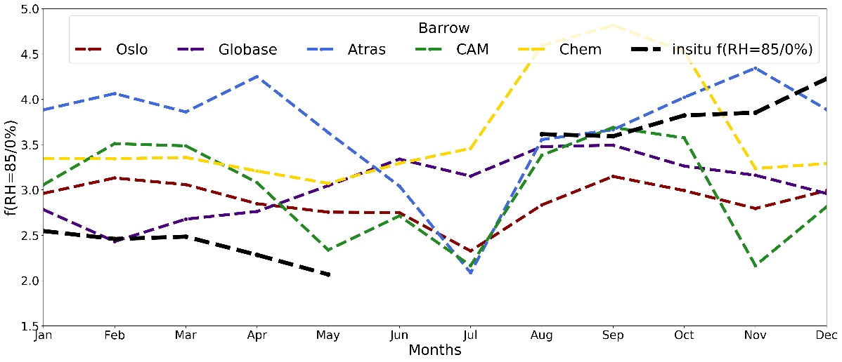
Models tend to overestimate
f(RH = 85/0 %) in late winter & spring
Underestimate
f(RH = 85/40 %) in autumn and start of winter
6

Slide 7
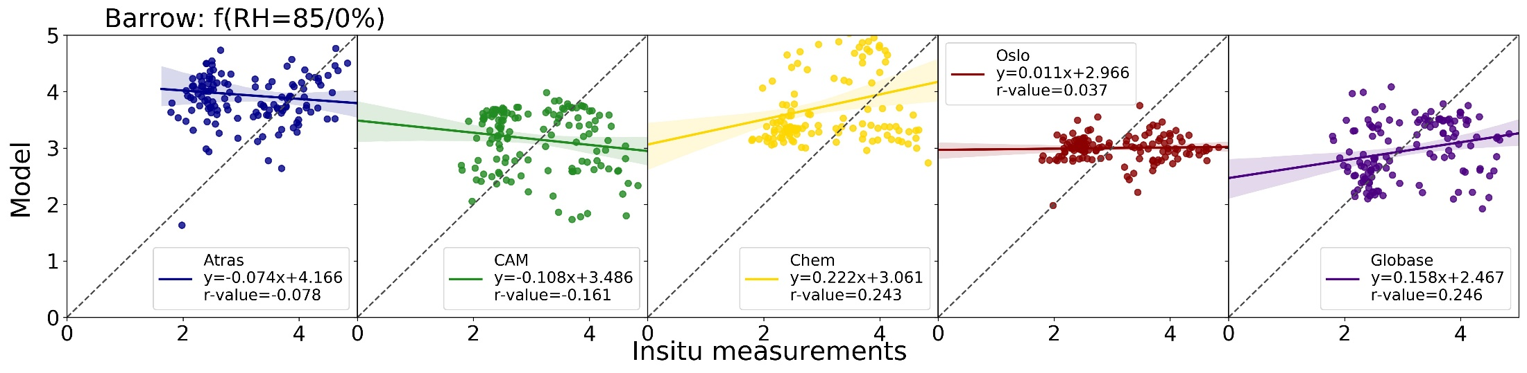
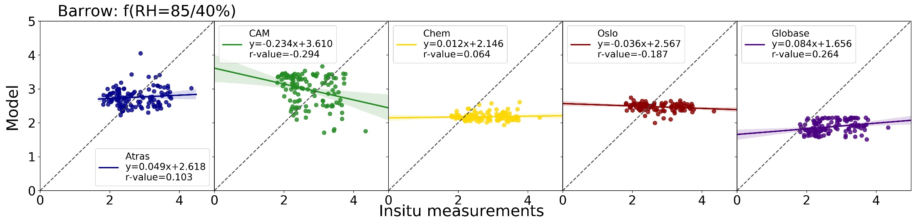
No correlation between models and measurements

Slide 8
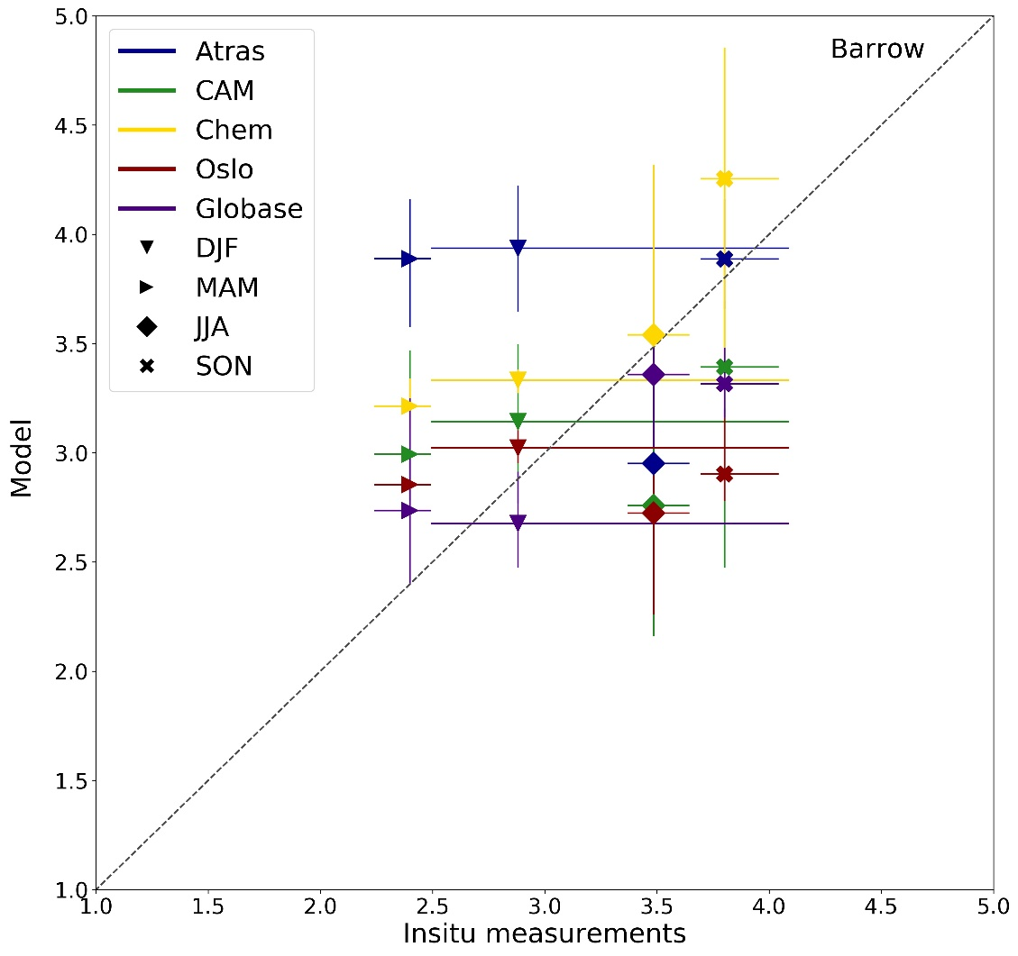
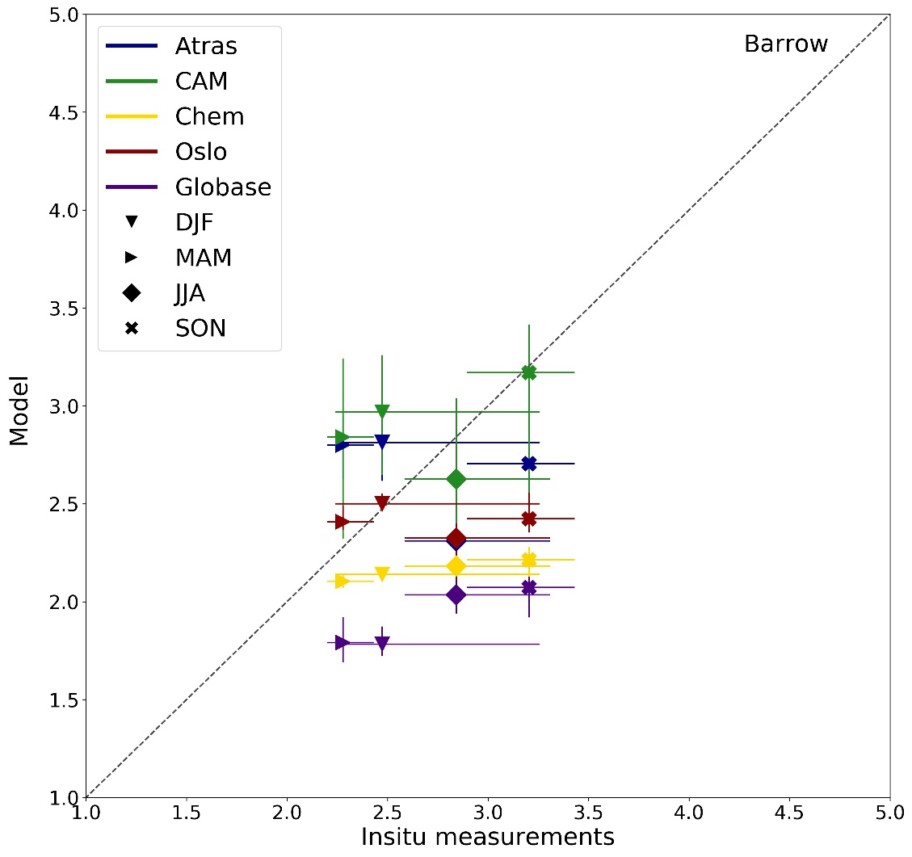
Winter spring overestimated
In the model
Summer and autumn underestimated in the
models
f(RH = 85/0 %)
f(RH = 85/40 %)

Slide 9
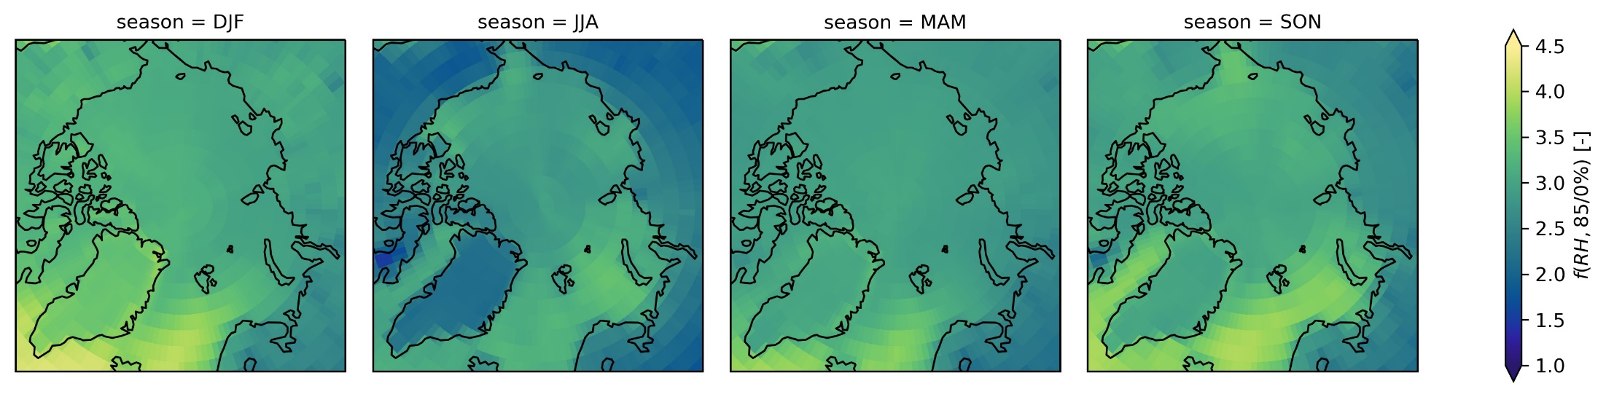
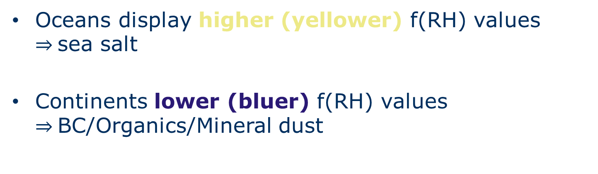
Oceans display higher (yellower) f(RH) values sea salt
Continents lower (bluer) f(RH) values BC/Organics/Mineral dust
Oslo

Slide 10
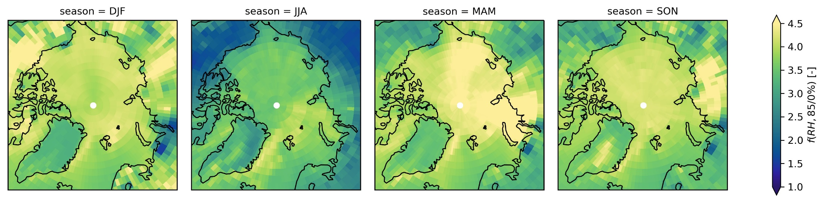
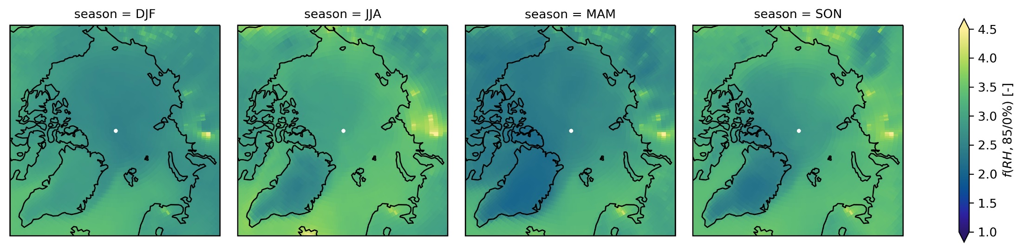
Atras
Globase

Slide 11
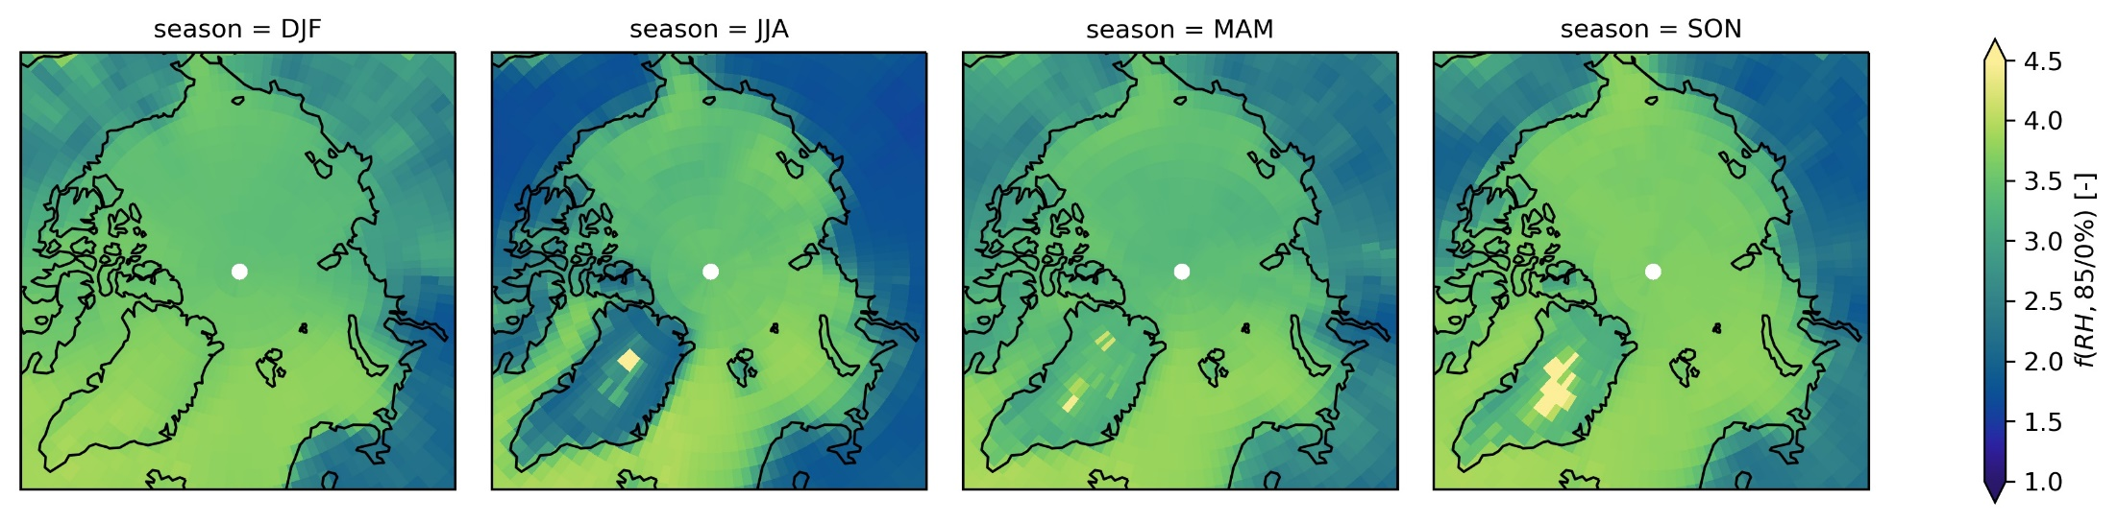
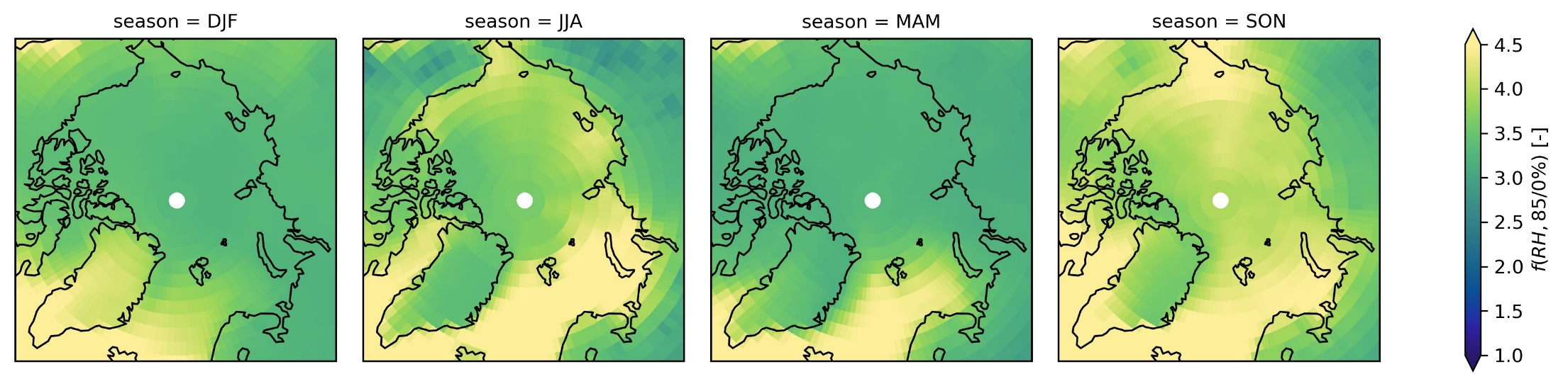
CAM
Chem

Slide 12
Conclusion
Models do not correlate with insitu measurements
Summer (JJA) lower, compared with other months
Summer/Autumn underestimated
Summer emissions BC/organics weighted too much in the models?
Sea spray emissions weighted too little?
Winter/Spring overestimated
Sea spray emissions weighted too much?
Sources from continent overestimated in models

Slide 13
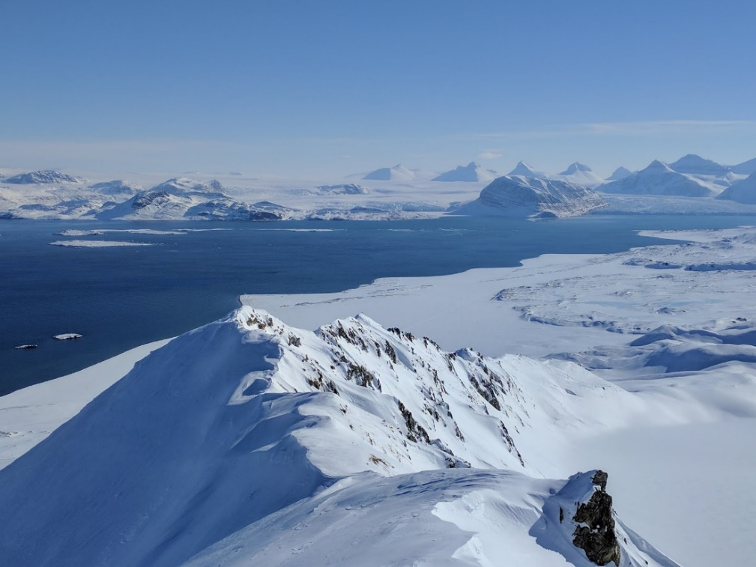
Thanks for listening
Questions?

